Slide 1
Chapter 17:
CHANGE OF PHASE

Slide 2
This lecture will help you understand:
Phases of Matter
Evaporation
Condensation
Boiling
Melting and Freezing
Energy and Changes of Phase

Slide 3
Phases of Matter
Matter exists in four common phases that involve transfer of internal energy:
  Solid phase (ice)
  Liquid phase (ice melts to water)
  Gaseous phase (water turns to vapor; addition of more energy vaporizes water to vapor)
  Plasma phase (vapor disintegrates to ions and electrons)

Slide 4
Phases of Matter
The phase of material depends upon the temperature and pressure.
Change from Solid → Liquid → Gas → Plasma requires energy to be added to the material.
Energy causes the molecules to move more rapidly.

Slide 5
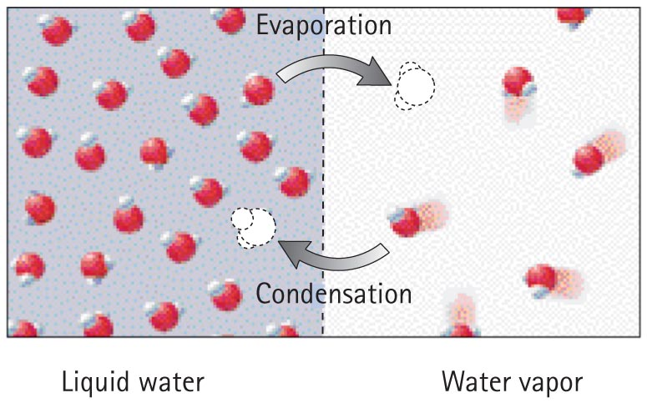
Evaporation
Evaporation
Change of phase from liquid to gas

Slide 6
Evaporation
Molecules in liquid move randomly at various speeds, continually colliding into one another.
Some molecules gain kinetic energy while others lose kinetic energy during collision.
Some energetic molecules escape from the liquid and become gas.
Average kinetic energy of the remaining molecules in the liquid decreases, resulting in cooler water.

Slide 7
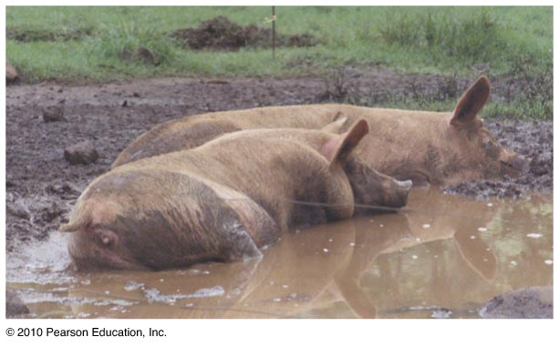
Evaporation
Important in cooling our bodies when we overheat
  Sweat glands produce perspiration.
  Water on our skin absorbs body heat as evaporation cools the body.
  Helps to maintain a stable body temperature.

Slide 8
Evaporation
Sublimation
Form of phase change directly from solid to gas
Example: dry ice (solid carbon dioxide molecules), mothballs, frozen water

Slide 9
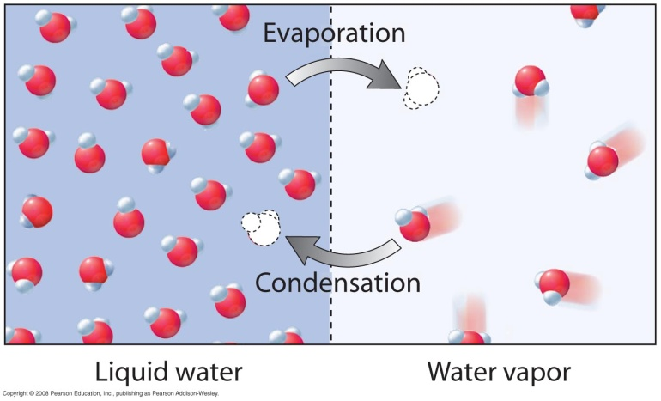
Condensation
Condensation process
Opposite of evaporation
Warming process from a gas to a liquid
Gas molecules near a liquid surface are attracted to the liquid
They strike the surface with increased kinetic energy, becoming part of the liquid

Slide 10
Condensation
Condensation process (continued)
Kinetic energy is absorbed by the liquid, resulting in increased temperature.
Examples:
  Steam releases much energy when it condenses to a liquid and moistens the skin—hence, it produces a more damaging burn than from same-temperature 100°C boiling water.
  You feel warmer in a moist shower stall because the rate of condensation exceeds the rate of evaporation.

Slide 11
Condensation
Condensation process (continued)
Examples:
  In dry cities, the rate of evaporation from your skin is greater than the rate of condensation, so you feel colder.
  In humid cities, the rate of evaporation from your skin is less than the rate of condensation, so you feel warmer.
  A cold soda pop can is wet in warm air because slow-moving molecules make contact with the cold surface and condense.

Slide 12
Condensation in the Atmosphere
The measure of the amount of water vapor in the air is humidity or mass of water per volume of air.
Relative humidity is the ratio of the present humidity to the greatest humidity or amount of water the air could hold at that temperature.
Saturation occurs when air temperature drops and water vapor begins condensing.

Slide 13
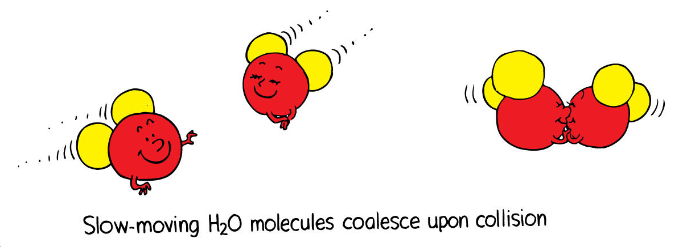
Condensation
Condensation in the atmosphere
When the temperature of the atmosphere is low, the water molecules in the air move slowly.
Slow-moving water molecules stick together, causing condensation.
Example: Fog and clouds created when air rises

Slide 14
If bits of coals do not stick to your feet when firewalking, it’s best if your feet are
Change of Phase
CHECK YOUR NEIGHBOR
A. wet.
dry.
sort of wet and sort of dry.
None of these.
Notes:
A. wet.

Slide 15
If bits of coals do not stick to your feet when firewalking, it’s best if your feet are
Change of Phase
CHECK YOUR ANSWER
A. wet.
dry.
sort of wet and sort of dry.
None of these.
Explanation:
The energy that vaporizes water is energy that doesn’t burn your feet.
Notes:
A. wet.

Slide 16
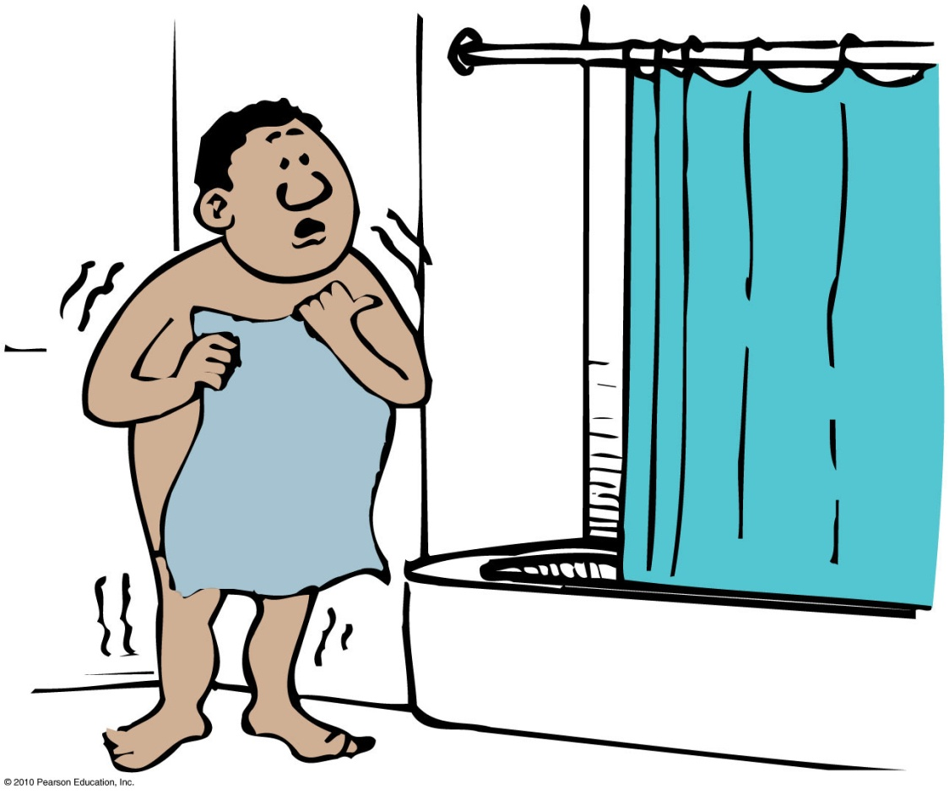
Condensation
CHECK YOUR NEIGHBOR
When you step out after a hot shower you feel cold, but you can feel warm again if you step back into the shower area. Which process is responsible for this?
Evaporation
Condensation
Both of these.
None of the above.

Slide 17
Condensation
CHECK YOUR ANSWER
When you step out after a hot shower you feel cold, but you can feel warm again if you step back into the shower area. Which process is responsible for this?
Evaporation
Condensation
Both of these.
None of the above.
Explanation:
When you step back into the shower area, the steam that is present condenses on your body, causing it to warm up.

Slide 18
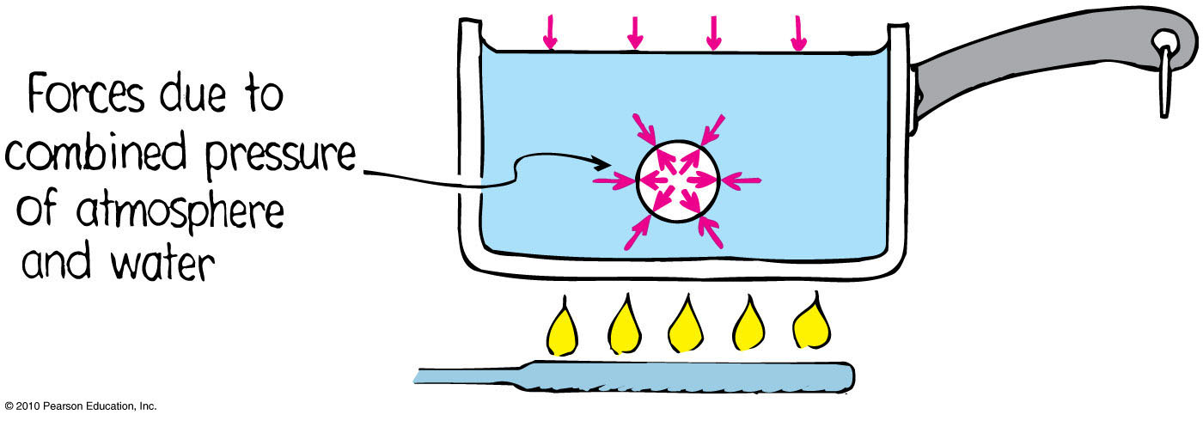
Boiling
Boiling process
Rapid evaporation from beneath the surface of a liquid.

Slide 19
Boiling
Boiling process (continued)
Rapid form of evaporation beneath the surface forms vapor bubbles.
Bubbles rise to the surface.
If vapor pressure in the bubble is less than the surrounding pressure, then the bubbles collapse.
Hence, bubbles don’t form at temperatures below boiling point (vapor pressure is insufficient).

Slide 20
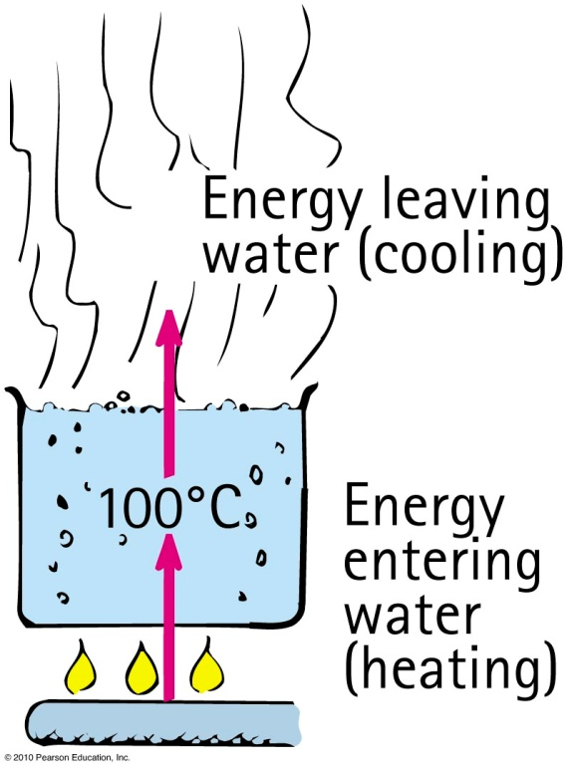
Boiling
Boiling process (continued)
Boiling water at 100°C is in thermal equilibrium—boiling water is being cooled as fast as it is being warmed.
In this sense, boiling is a cooling process.

Slide 21
Boiling
Boiling point depends on pressure.
  Example: Buildup of vapor pressure inside a pressure cooker prevents boiling, thus resulting in a higher temperature that cooks the food.
Boiling point is lower with lower atmospheric pressure.
Example: Water boils at 95°C in Denver, CO (high altitude) instead of at 100°C (sea level).

Slide 22
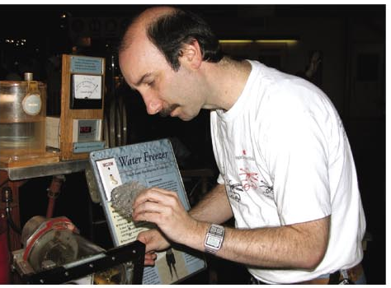
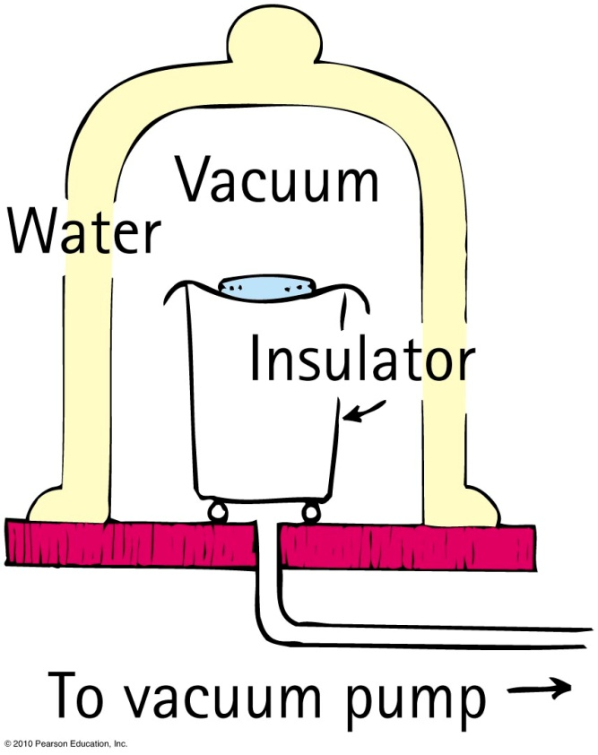
Boiling
Demonstration of cooling effect of evaporation and boiling

Slide 23
The process of boiling
Boiling
CHECK YOUR NEIGHBOR
A. cools the water being boiled.
depends on atmospheric pressure.
is a change of phase below the water surface.
All of the above.
Notes:
D. all of these.

Slide 24
The process of boiling
Boiling
CHECK YOUR ANSWER
A. cools the water being boiled.
depends on atmospheric pressure.
is a change of phase below the water surface.
All of the above.
Notes:
D. all of these.

Slide 25
Melting and Freezing
Melting
Occurs when a substance changes phase from a solid to a liquid
Opposite of freezing
When heat is supplied to a solid, added vibration breaks molecules loose from the structure and melting occurs.

Slide 26
Melting and Freezing
Freezing
Occurs when a liquid changes to a solid
Opposite of melting
When energy is continually removed from a liquid, molecular motion decreases until the forces of attraction bind them together and formation of ice occurs.

Slide 27
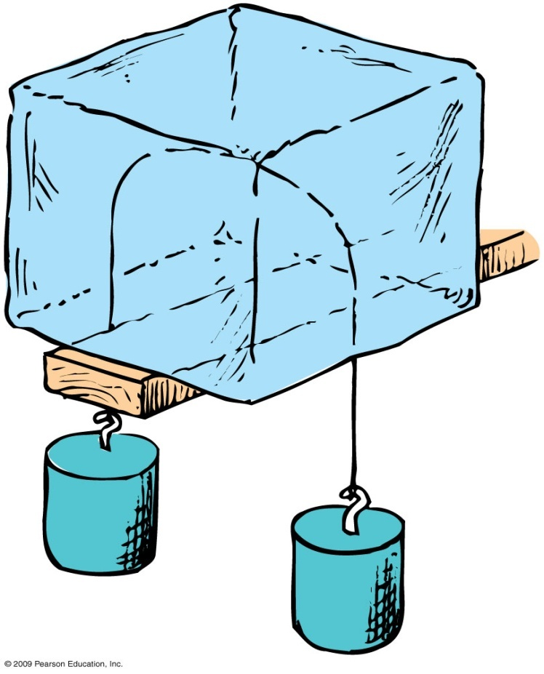
Regelation
Locally applied pressure can cause solids to change phase.
The pressure crushes the crystal to the liquid phase.
Snowballs are formed when we compress the snow flakes into a sort of solid.

Slide 28
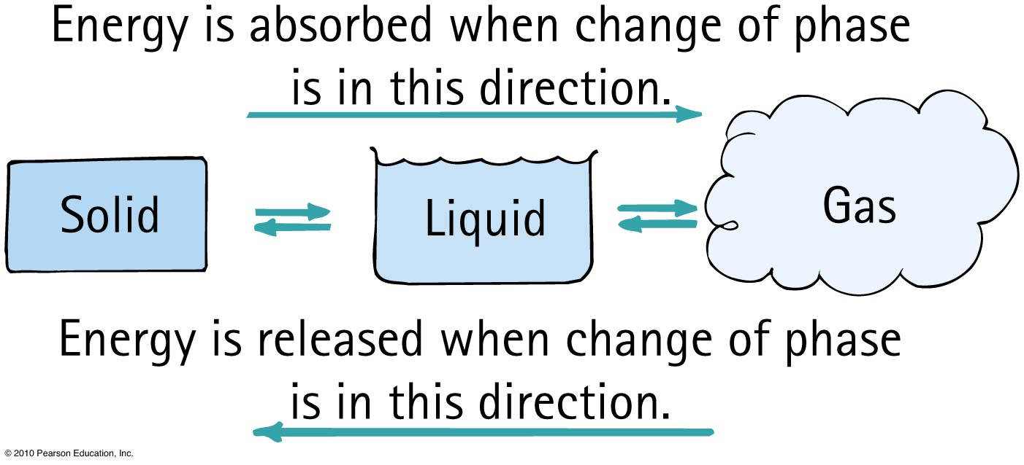
Energy and Change of Phase
Energy and Change of Phase
From solid to liquid to gas phase
  add energy
From gas to liquid to solid phase
  remove energy

Slide 29
Energy and Change of Phase
Example of both vaporization and condensation processes
  Cooling cycle of refrigerator pumps a special fluid that vaporizes and draws heat from stored food. The gas that forms, along with its energy, is directed to the condensation coils outside the fridge where heat is released and the fluid condenses back to liquid.
  Air conditioner pumps heat energy from one part of the unit to another.

Slide 30
Energy and Change of Phase
Heat of fusion
Amount of energy needed to change any substance from solid to liquid and vice versa
Examples:
  Heat of fusion for water is 334 joules/g.
  Farmers in cold climates replace frozen tubs of water with unfrozen ones in their cellars to prevent jars of food from freezing.

Slide 31
Energy and Change of Phase
Heat of vaporization
Amount of energy needed to change any substance from liquid to gas and vice versa
Examples:
  Heat of vaporization for water is 2256 joules/g.
  In briefly touching a hot skillet, energy that normally would flow into your finger instead vaporizes water. Hence, you’re not burned.

Slide 32
When snow forms in clouds, the surrounding air is
Energy and Change of Phase
CHECK YOUR NEIGHBOR
A. cooled.
warmed.
insulated.
thermally conducting.
Notes:
B. warmed.

Slide 33
When snow forms in clouds, the surrounding air is
Energy and Change of Phase
CHECK YOUR ANSWER
A. cooled.
warmed.
insulated.
thermally conducting.
Explanation:
The change of phase is from gas to solid, which releases energy.
Notes:
B. warmed.

Slide 34
Which involves the greatest number of calories?
Energy and Change of Phase
CHECK YOUR NEIGHBOR
A. Condensing 1 gram of 100°C steam to 100° water
Cooling 1 gram of 100°C water to 1 gram of 0°C ice
Cooling 1 gram of 0°C ice to near absolute zero
All about the same.
Notes:
A. Condensing 1 gram of 100°C steam to 100° water.

Slide 35
Which involves the greatest number of calories?
Energy and Change of Phase
CHECK YOUR ANSWER
A. Condensing 1 gram of 100°C steam to 100°C water
Cooling 1 gram of 100°C water to 1 gram of 0°C ice
Cooling 1 gram of 0°C ice to near absolute zero
All about the same.
Explanation:
540 calories is more than the 100 calories for B, and half of 273 calories to cool ice (the specific heat of ice is about half that for liquid water).
Notes:
A. Condensing 1 gram of 100°C steam to 100°C water.

Slide 36
Ice is put in a picnic cooler. To speed up the cooling of cans of beverage, it is important that the ice
Energy and Change of Phase
CHECK YOUR NEIGHBOR
A. melts.
is prevented from melting.
be in large chunks.
None of the above.
Notes:
A. melts.

Slide 37
Ice is put in a picnic cooler. To speed up the cooling of cans of beverage, it is important that the ice
Energy and Change of Phase
CHECK YOUR ANSWER
A. melts.
is prevented from melting.
be in large chunks.
None of the above.
Explanation:
For each gram of ice that melts, 540 calories is taken from the beverage.
Notes:
A. melts.

